Slide 1
Data Types
In C Language

Slide 2
Two Categories of Data
integer data
And real data

Slide 3
bytes allocated for each data type
Signed types | unsigned types | Size in bytes
Negative, 0 and Positive Values | Only 0 and Positive Values
char | unsigned char | 1
short | unsigned short | 2
short int | unsigned short int | 2
int | unsigned int | 4
long | unsigned long | 8
long int | unsigned long int | 8
long long | unsigned long long | 8
long long int | unsigned long long int | 8

Slide 4
Integer Data Types
Signed types | unsigned types
char | unsigned char
short | unsigned short
short int | unsigned short int
int | unsigned int
long | unsigned long
long int | unsigned long int
long long | unsigned long long
long long int | unsigned long long int

Slide 5
Signed Data Ranges
Signed types | Data Range
char | -128 to 127
short | -32768 to 32767
short int | -32768 to 32767
int | -2147483648 to 2147483647
long | -9223372036854775808L to 9223372036854775807L
long int | -9223372036854775808L to 9223372036854775807L
long long | -9223372036854775808L to 9223372036854775807L
long long int | -9223372036854775808L to 9223372036854775807L

Slide 6
Unsigned Data Ranges
unsigned types | Data Range
unsigned char | 0 to 255
unsigned short | 0 to 65535
unsigned short int | 0 to 65535
unsigned int | Zero to 4294967295
unsigned long | Zero to 18446744073709551615
unsigned long int | Zero to 18446744073709551615
unsigned long long | Zero to 18446744073709551615
unsigned long long int | Zero to 18446744073709551615

Slide 7
Two Categories of Data
integer data
And real data

Slide 8
Real Data Type Sizes
Real | Size in Bytes
float | 4
double | 8
Long double | 16

Slide 9
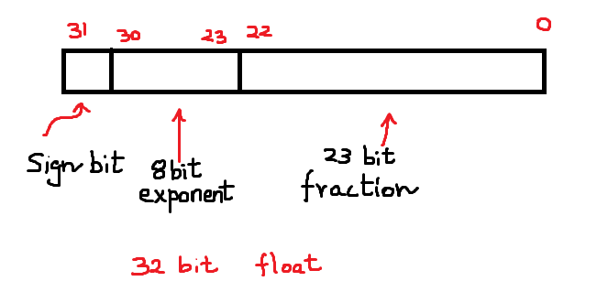

Slide 10
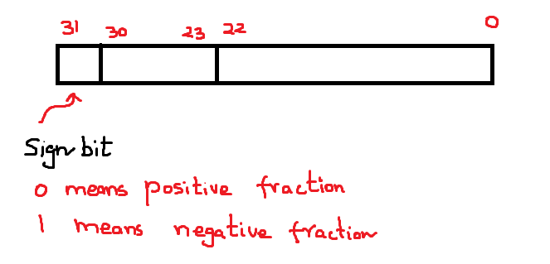
meaning of sign bit

Slide 11
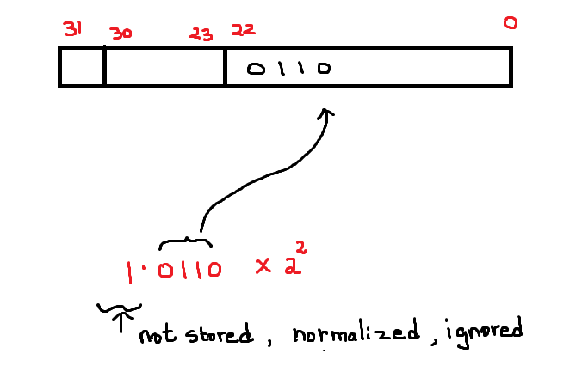

Slide 12
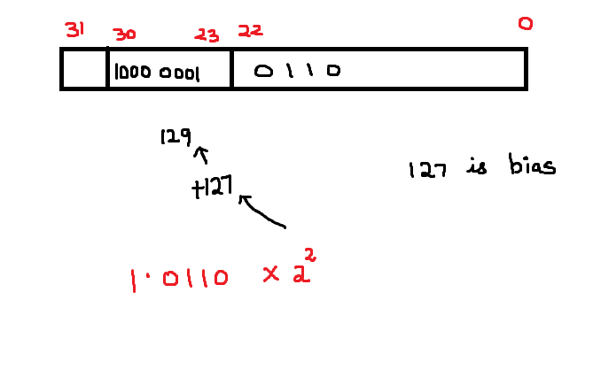

Slide 13
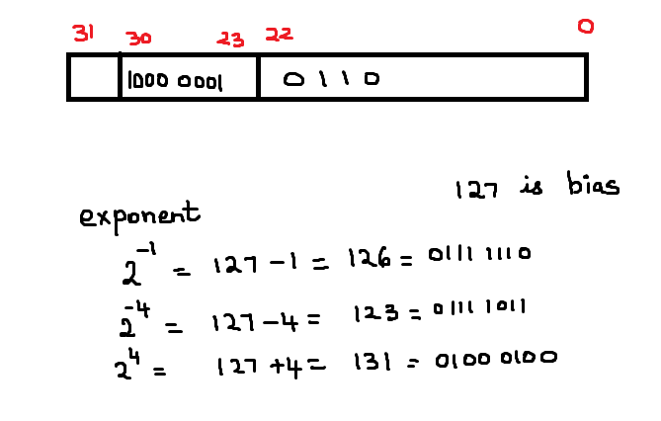

Slide 14
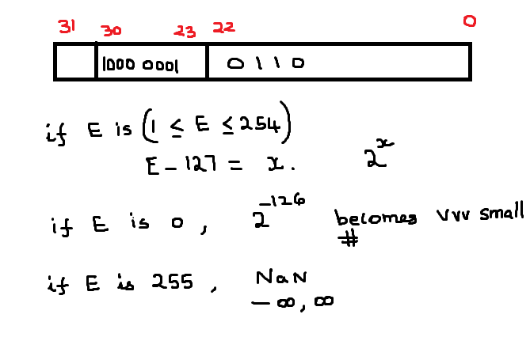
Interpretation of the bits stored in 23-30 position – 8 bits. Range is 0 to 255.

Slide 15
Interpretation of the bits stored in 23-30 position – 8 bits. Range is 0 to 255.
No negative numbers.
maximum power = +128
minimum power = -126

Slide 16
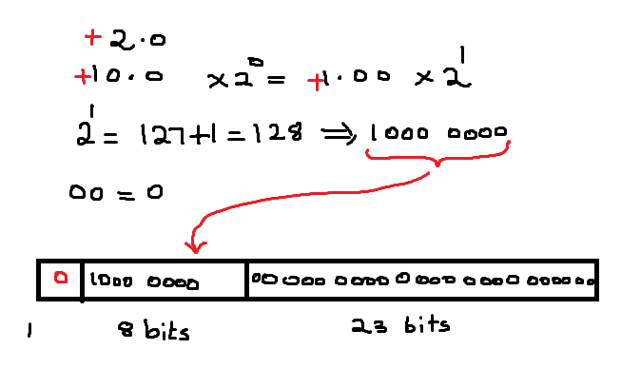

Slide 17
